Slide 1
Welcoming Newcomers to our Parish
Insert Name
Notes:
Welcome attendees and introduce yourself

Slide 2
Who are the Newcomers?
Refugees
Asylum Seekers
Migrants
Bogus Asylum Seeker
Modern Slaves
?
Notes:
Here are some definitions
Refugee – The UNHCR defines a refugee as someone who has been forced to flee his or her country because of persecution, war or violence. A refugee has a well-founded fear of persecution for reasons of race, religion, nationality, political opinion or membership in a particular social group. Here in the UK a person claims asylum and if this claim is accepted they become a refugee and have the legal right to remain in the UK. Once someone receives refugee status, they have 28 days to move out of Asylum accommodation into other accommodation, apply for benefits. At this stage many refugees become homeless.
Asylum Seeker – A person who claims to be a refugee but whose claim has yet to be assessed. As an Asylum seeker people are not allowed to work and are not entitled to benefits. If they have no resources they are able to claim housing and asylum support which is currently £5.39 a day. This money is for all food and travel expenses as well as personal items such as clothes and toiletries. The houses offered to asylum seekers are often the ‘hard to let’ properties other council tenants do not want to live in.
Migrant – is defined as any person who moves over an international border. Many migrants are now increasingly vulnerable to pressure placed on all migrants by the hostile environment. They are expected to prove their right to stay in the UK to health and education authorities before accessing Support
Bogus Asylum Seeker - There is no such thing as a bogus asylum seeker or an illegal asylum seeker. As an asylum seeker, a person has entered into a legal process of refugee status determination. Everybody has a right to seek asylum in another country. People who don't qualify for protection as refugees will not receive refugee status and may be deported, but just because someone doesn't receive refugee status doesn't mean they are a bogus asylum seeker.
Let us remember that a bogus asylum-seeker is not equivalent to a criminal; and that an unsuccessful asylum application is not equivalent to a bogus one - Kofi Annan
Modern Slaves – The NHS uses this definition to describe modern slavery. “Modern slavery is the recruitment, movement, harbouring or receiving of children, women or men through the use of force, coercion, abuse of vulnerability, deception or other means for the purpose of exploitation.” Modern Slavery is happening all over the world and when victims are discovered they are often treated as illegal migrants rather than the victiom of a crime. This can mean that they feel less confident coming forward and alerting authorities to the abuse that they are suffering.

Slide 3
Nehar’s Story
A bedroom at Sophia House
Notes:
Nehar is a young woman from East Africa who arrived as an asylum seeker with her husband. With the support of Women’s Aid she found safety from domestic abuse and lived in asylum support shared-accommodation. In December she was granted refugee status - the Home Office agreed her asylum case, granting sanctuary in the UK. Once refugees have status they have to secure new accommodation and their minimal asylum support ends. Due to Nehar’s shared accommodation and English skills she missed the communication, finally getting a letter the Friday before Christmas which she took to her English lesson. They made an urgent referral to Sophia House, a Father Hudson’s Care project, as she had to leave her accommodation that day. Nehar was welcomed with a room in a safe, warm, welcoming home. Sophia House staff and volunteers have supported her to secure a bank account, welfare, a GP and to settle into the local area. Nehar wants to work in health and social care with an aspiration to be a Doctor. We are now supporting her to attend college open days.
Receiving refugee status is a complicated process made more difficult for people who do not speak English. Nehars case was made more difficult as she was forced to flee domestic abuse while she was in claiming asylum. Wit the support of local charities she has been able to start rebuilding her life in the UK.

Slide 4
Notes:
Here are some statistics about the number of refugees in the UK
The UK receives approximately 6% of asylum claims in Europe and is not in the top 10 of refugee and asylum seeker hosting countries across the world. In Europe Germany receives the most new asylum claims each year.
According to UNHCR (United Nations High Commission for Refugees) statistics from 2016 show the UK received the 55th highest number of refugees when ranked by the number of refugees per head of population (that is 1.83 per 1,000 people and
the 89th most refugees when ranked as refugees per 1 million USD (GDP) that is 0.05 refugees per $1 million Gross Domestic Product. This can be compared to South Sudan which receives 90.10 refugees per Million $ of GDP and 20.62 per 1,000 inhabitants
85% of the words refugees are hosted by developing countries
Most refugees stay in their region of origin, Turkey now hosts the highest number of refugees with 3.5 million people followed by Pakistan and Uganda who each host 1.4 million people. In one week in May 2019 one district in Syria’s Idlib Province – Dana district – has received more than 123,000 people displaced by airstrikes and shelling.
All these statistics say that the majority of refugees are living in countries that can least afford to support them.
However there is a positive impact of refugees on society The Washington Post recently reported that in Germany they are working to integrate refugees that arrived in the with 44,000 people in vocational training for shortage skills and 400,000 in work contributing to the wealth of Germany. Many of the remaining refugees that have arrived in Germany are on programs to help integrate them with their new society, based on the integration programs trialled in the 80’s and 90’s

Slide 5
Migration and Benefits
Notes:
The Majority of non-EEA nationals are considered to have No Recourse to Public Funds (NRPF) they are allowed access to the public services such as the NHS but are charged a £200 per year surcharge in addition to the cost of their visa. They become eligible to receive public funds once they are granted permanent residence.
Asylum Seekers are also not eligible to receive public funds, they are can receive somewhere to live and a cash allowance of £37.75 (approximately £5.39 per day) if they are defined as destitute. The accommodation that they receive is generally accommodation that has been refused by people on the council housing waiting list and the cash allowance is to cover food, toiletries, travel to appointments . Asylum seekers cannot choose where they live or the type of accommodation that they are given.
EU migrants are not eligible to receive benefits within the first three months of living in the UK and there are restriction on the access to benefits after this if there is deemed to be a low chance of finding work in the UK. EU migrants cannot claim housing benefit.
So beware of click bait designed to cause upset. If you would like more information about migration check out fullfact.org which aims to be independent and neutral.
Here is Marsha’s story she came to the UK from Jamaica and recently visited Brushstrokes with clothing donations. When thanked for these she explained that she felt she owed a debt having been helped by us in 2012 when she was heavily pregnant. Marsha described how, with just two weeks to go before giving birth to her son, Brushstrokes gave her baby clothes, a cot and a pushchair plus sufficient financial assistance to pay for a car seat, a bunk bed, a cooker and a fridge. She says, ‘I know how it feels to have nothing and to rely on charity. At first my pride made it difficult to accept help but you treated me with dignity so that I was able to receive things. I was overwhelmed by your understanding and just want to return gifts to you so you can help others who are now in the position I once was. Now, I am back on my feet, and if I could I’d spend a fortune in shops and give it all to you.’
Marsha is now studying for her Master’s Degree in Nursing at the University of Wolverhampton as well as bringing up her children. Her income on arrival was not enough to support her and her young children without the support of charities.

Slide 6
Modern Slavery
Notes:
Modern Slavery can take many forms the Walk Free Foundation defines modern Slavery as "situations of exploitation that a person cannot refuse or leave because of threats, violence, coercion, abuse of power or deception“
This means modern slavery can include:
Industry – people are forced to work long hours in dangerous unregulated conditions for little or no pay. If they try to leave they are threatened with or are the victim of violence.
Forced Marriage and Sexual Slavery – Predominantly women and children are offered work in other industries before being sold in brothels or individuals and forced to pay back their “debt” for living expenses and for the journey to their new residence. This takes place all over the world.
In homes – some modern slaves live in homes and private sites. There are regularly news stories about people forced to live in terrible conditions and work for free or for little money. These slaves are not in the public eye and are rarely seen on the street but are probably living in homes across the country.
This is the story of one modern slave who was supported by Brushstrokes, Bill was 19 years old when Brushstrokes first met him on his doorstep. He had been trafficked in to the UK when he was nine and forced into slavery where he sustained lifelong physical and mental injuries. He never went to school and taught himself how to read and write. He escaped two years before we met him. Our support transformed his life. We helped him into education and he gained GCSE’s in Maths and English. We supported him to claim Criminal Injuries compensation. We dealt with all correspondence on his behalf and he was awarded £30,909.00 from the Criminal Injuries Compensation Authority (CICA), which was enough to pay for his course to become a gas engineer.

Slide 7
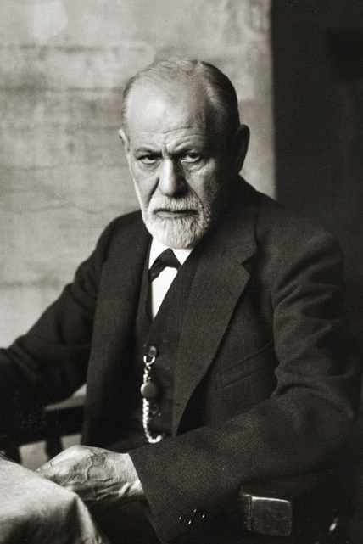
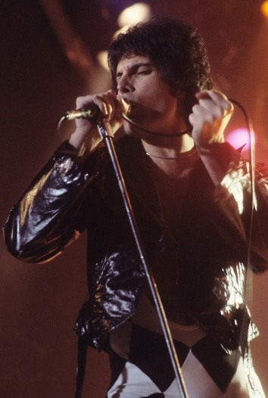
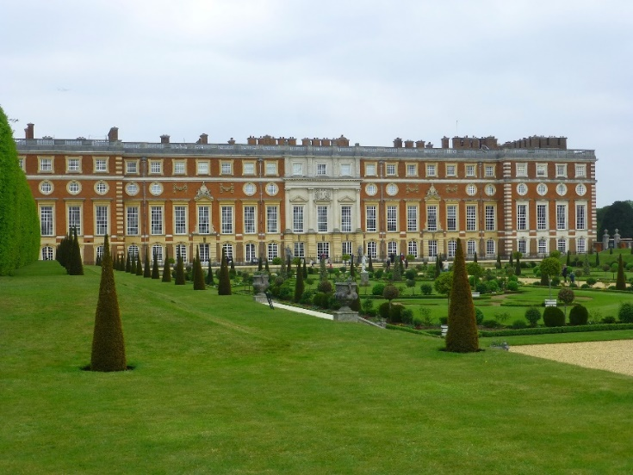
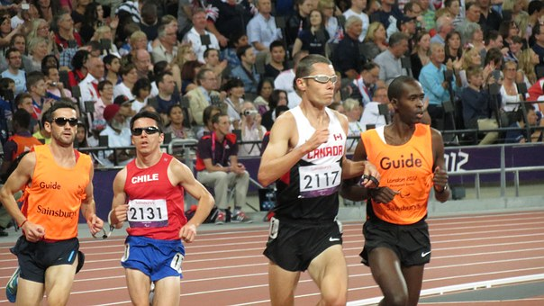
How Refugees have contributed to Britain
Notes:
Britain has a long history of welcoming refugees, from the Huguenots fleeing religious persecution in France in the 1570’s and 1680’s. The welcome of 70,000 Jewish refugees prior to the outbreak of world war 2 including 10,000 children who arrived through the Kindertransport at the same time as the welcoming 4,000 children from the Basque region of Spain during the Spanish civil war in response to the bombing of civilians at Guernica. Later uprisings against soviet rule when approximately 20,000 Hungarians came to the UK in 1956 and following the 1973 by Ugandan Asians fleeing the regime of Idi Amin
Although many of these groups have faced opposition and at times racism over time they have been welcomed into UK and help form and the country that we recognise today. Here are some examples of individual contributions made by refugees.
Daniel Marot was invited by William and Mary to work on Hampton Court Palace, this work included the gardens which have recently been restored and work on the interior of the palace Hampton Court Palace including the state rooms introducing what is now known as the William and Mary style to Britain
Michael Marks of Marks and Spencer was a Russian Refugee who arrived in Britain in 1882
Freddie Mercury Was born in Zanzibar but he and his family fled worsening tensions to settle in Middlesex other noted musicians who were refugees include Rita Ora – who was born in Kosovo during the Yugoslav wars but left at the age of 1 , M.I.A. whose Tamil parents fled Sri Lanka as political refugees. In addition to Carlos Acosta, a ballet dancer with Royal Ballet is a Cuban Refuge. All have made an impact on the culture and arts of Britain and the world.
Sigmund Freud and his Daughter Anna pioneers in psychoanalysis left Austria after the Nazi’s seized control of Austria for London with many members of their family although Sigmund Freud lost 4 sisters in concentration camps.
Professor Sir Ludwig Guttmann – founder of the Paralympics and the spinal injuries unit of Stoke Mandeville hospital, also fled the Nazi’s
Alek Wek fled the Civil War in Sudan with her family before becoming a supermodel and designer working with fashion houses across the world.

Slide 8
Sheim’s Story
Notes:
The story of Sheim and his family illustrates how effective the right support can be. Sheim was forced to flee Afghanistan because of his work as an interpreter for the United Nations. At risk from the Taliban and he had no choice but to move his family to a place of safety. That place of safety was Britain. Dispersed to Sandwell, they arrived in a poor state. Deeply traumatised, scarred by their previous experiences, with no knowledge of the UK and how our society works, friendless and alone except for each other. Only Sheim spoke English. Brushstrokes supported the family to find a place to live, beds to sleep on, essential goods like a cooker and furniture. Suitable schools were found for the children, Brushstrokes supported Sheim to navigate the benefits system and Mum was helped to find an English class. Brushstrokes also supported Sheim into a placement at a local housing association so his many talents wouldn't go to waste. He was offered a job giving him enormous self-worth, financial security and the opportunity to contribute. The family is now thriving as a direct result of this support.
For Sheim and many people like him it is the opportunity to contribute to their new home country, provide for their family and be valued for their skills and experience that can mean the most. Moving away from being dependent on others is essential to the self- worth of people in the immigration system.
This photo shows one of the ESOL (English for speakers of other languages) classes held at Brushstrokes in Sandwell throughout the year.

Slide 9
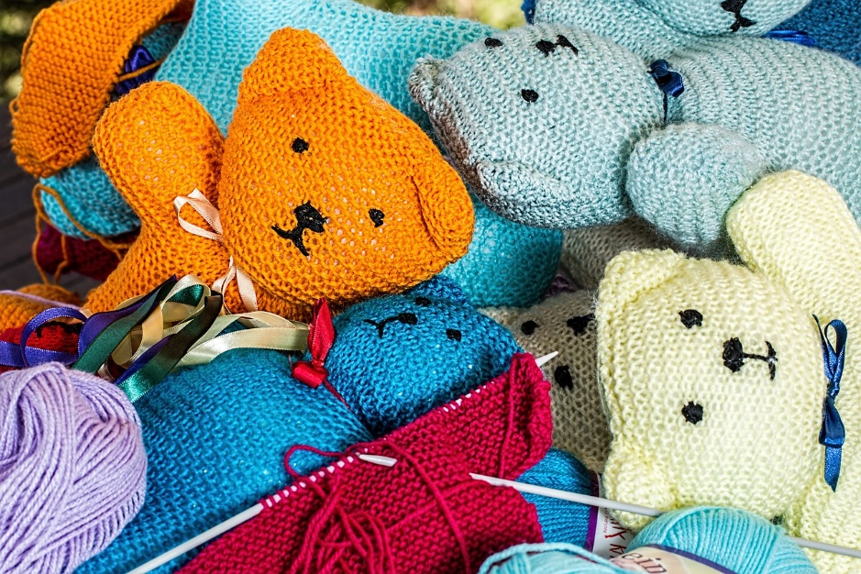
How Can I help
Contact a local project and find out what they need
Share Information with others
Show your support
Volunteer at a local project
Notes:
Contact a local project and find out what they need
Get creative and knit a blanket or a jumper
Have a clear out of your wardrobe or kitchen
Donate practical items such as laundry detergent
Buy Christmas Presents or Easter Eggs for Children and their families that would otherwise go without
Share information and facts invite a refugee or a professional to speak at your church or event
Show your support for refugees, asylum seekers and vulnerable migrants. With so many negative stories about asylum seekers share your groups support for people in need.
Volunteer at a local project – the support refugees and need as well as support available varies from area to area look into existing groups and see if they need volunteers or if there is a gap in services could you be the people to fill it?

Slide 10
For More Information
Father Hudson’s Care – Father Hudson’s Care provides help and support to five community projects that support Newcomers to the Archdiocese of Birmingham
You can also visit the Caritas Archdiocese of Birmingham website for more information about supporting newcomers
Other websites that provides useful information include Refugee Action, UNHCR and

